Slide 1
End-of-Year
Marketing Report
Sinclair Verde Lamp Company

Slide 2
Agenda
1. | Learning the Marketing Goal
2. | End-of-Year Overview
3. | Holiday Season Report
4. | Conclusion

Slide 3
The Goal

Slide 4
The Goal
The three primary marketing goals for the Sinclair Verde Lamp Company are:
Create brand awareness
Drive visits to the physical store
Increase online holiday sales by 3 percent

Slide 5
End-of-Year Overview
This section will give a review of the marketing trends presented in the analytics report.

Slide 6
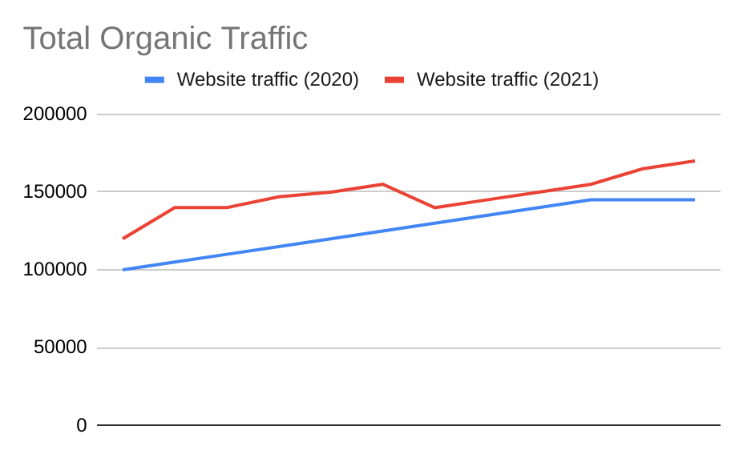
Organic traffic
In 2021, we experienced an overall increase organic traffic to the Sinclair Verde website.
In January, we started with 120000 organic searches.
We ended December with (141.67)% organic searches.
This is up 17.24% from last year.
Notes:
Chart shows total organic traffic data for 2020 and 2021

Slide 7
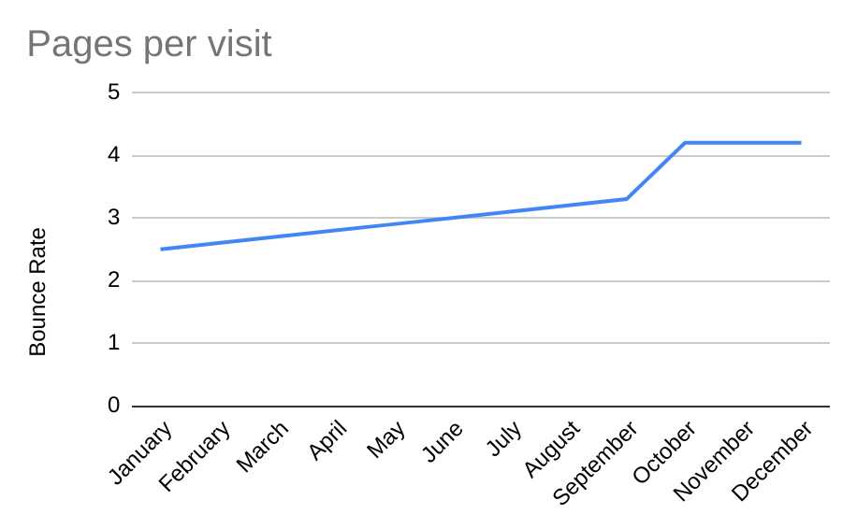
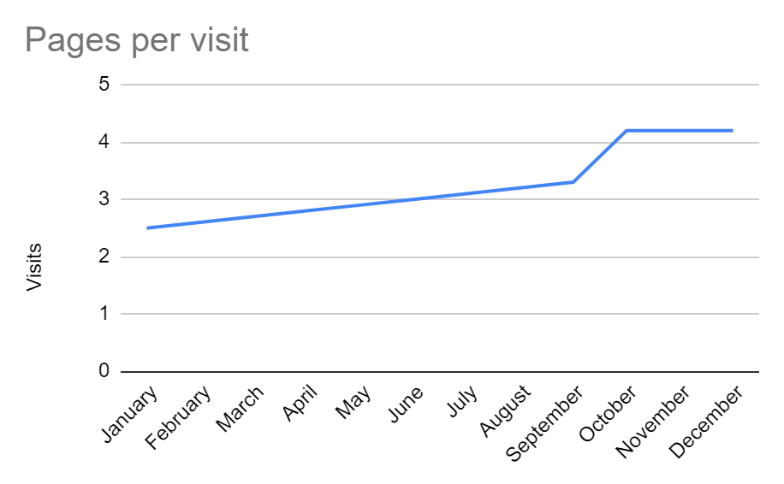
Notes:
Graph displays pages per customer visit rates between January and December. The pages increased until october where it plateaued until december.

Slide 8
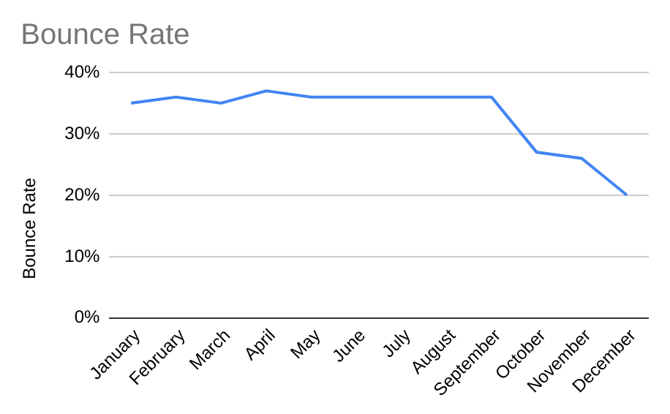
Notes:
Graph shows bounce rate by percentage between January and December. The bounce rate started decreasing on September and continued until December.

Slide 9
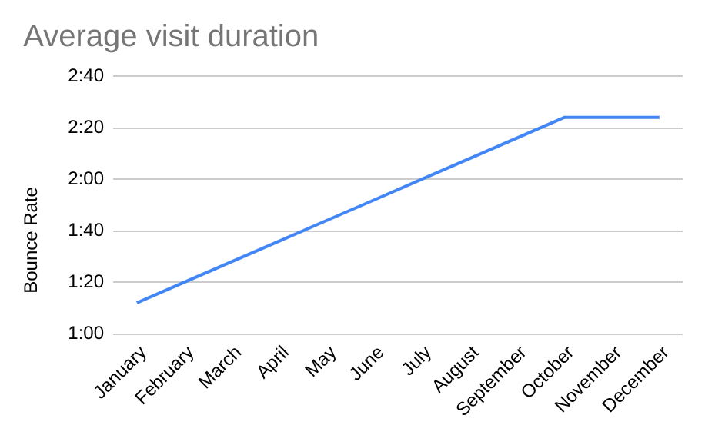
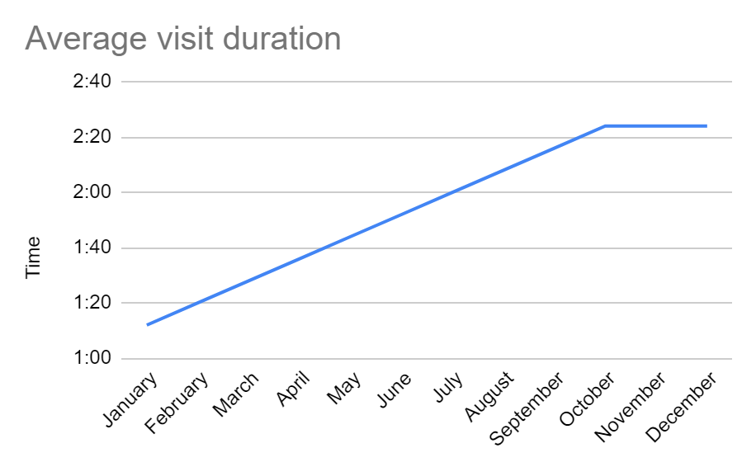
Notes:
Chart shows average visit duration between January and December. The average visit duration steadily increased until october where it stabilize to 2:20 per visit.

Slide 10
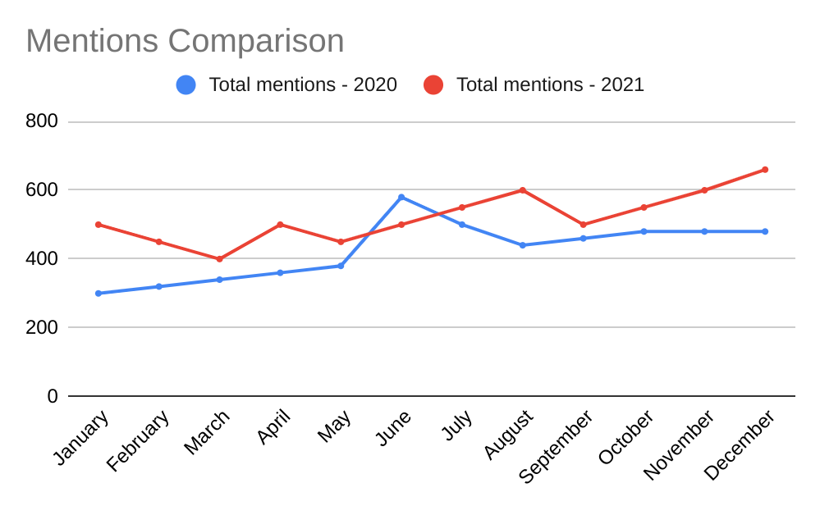
Social media mentions
In January, there were(500) social media mentions.
In December, there were (660).
Notes:
Chart shows social media total mention comparisons between 2020 and 2021

Slide 11
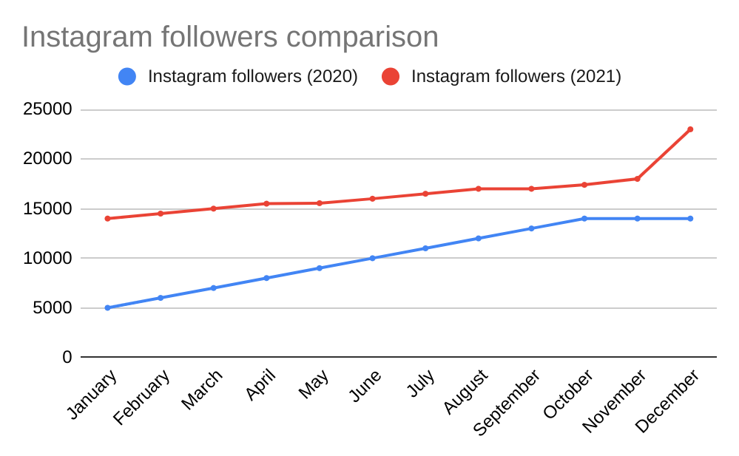
Instagram followers
Followers also increased. In 2021, the Sinclair Verde social media page gained(9000) followers.
This was 64% greater than the previous year.
Notes:
Chart shows total number of Instagram followers for 2020 and 2021

Slide 12
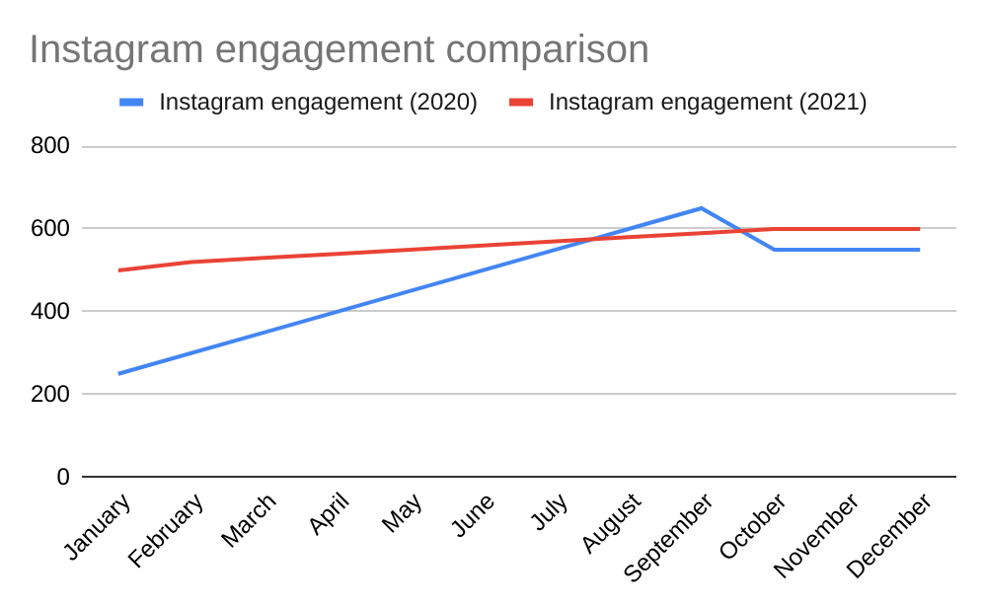
Instagram engagement
In January, there were 500 Instagram enegagements.
In December, there were 600 Instagram enegagements.
This shows a 9% increase from the previous year.
Notes:
Chart shows total number of Instagram engagements for 2020 and 2021

Slide 13
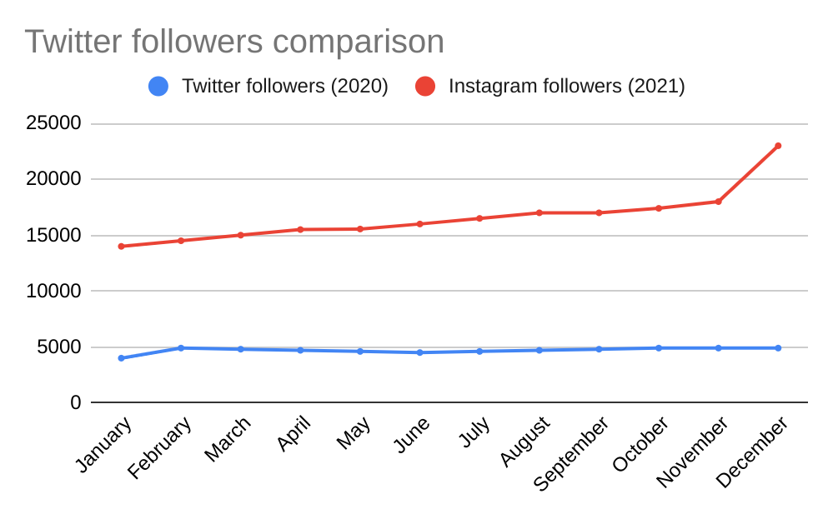
Twitter followers
In January, there were 5000 Twitter followers.
In December, there were 6800 Twitter followers.
This shows a 39% increase from the previous year.
Notes:
Chart shows total number of Twitter followers for 2020 and 2021

Slide 14
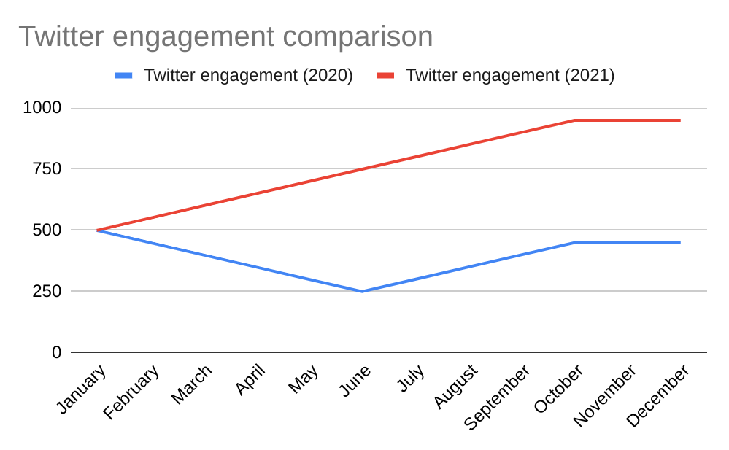
Twitter engagement
In January, there were 500 Twitter engagements.
In December, there were 950 Twitter engagements.
This shows a 111% increase from the previous year.
Notes:
Chart shows total number of Twitter engagements for 2020 and 2021

Slide 15
Holiday Season Report
This section summarizes the data presented in the analytics report, specifically focusing on the months of November and December.

Slide 16
Organic Performance
 | November (Month 11) | December Month 12 | Net Growth:
2020 Holiday Season | 60000 | 70000 | 0%
2021 Holiday Season | 165000 | 170000 | 3.03%
Notes:
We had a net growth of 3.03% in organic traffic from 2020 to 2021.

Slide 17
Conclusion
In this section, we will summarize the overall success of the campaign and make predictions about the upcoming year.

Slide 18
Conclusion
In conclusion, the overall marketing data suggests that we are steadily increasing brand awareness. We also met the 3% growth we are aiming for. However, we do not know if website traffic drives physical store traffic, and the performance of social and paid sources are terrible we should either focus on organic and direct traffic, or fix the strategy for paid and social traffic.
Based on this data, Good Mercury Marketing predicts that in the upcoming year based on the trend we should expect more traffic in our website, and increased social media followers and engagement.

